Slide 1
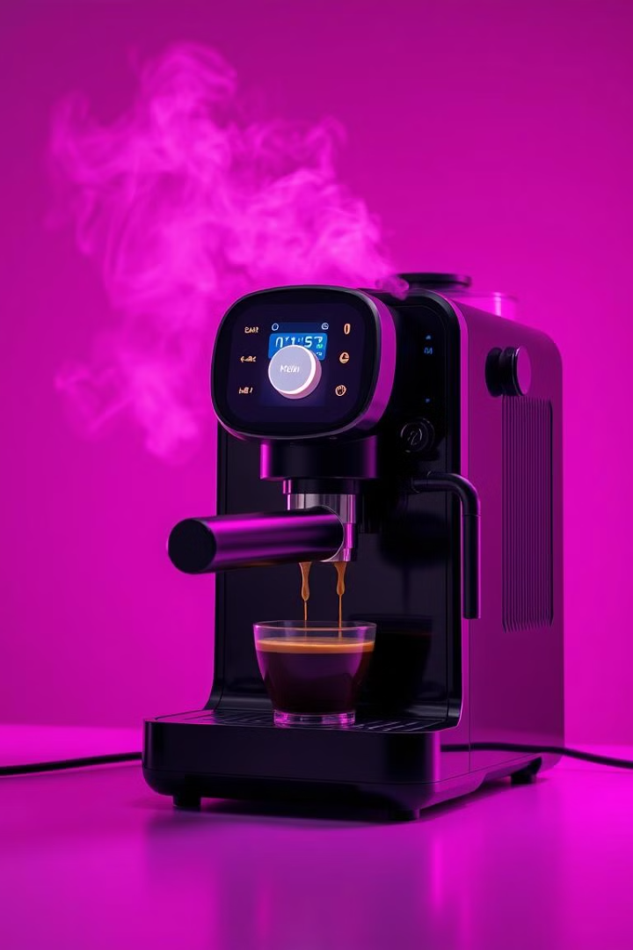
Building a Coffee Machine Program in Python
This presentation explores how to implement a simple coffee machine program using Python, covering key elements like defining recipes, managing stock, handling transactions, and controlling the machine.

Slide 2
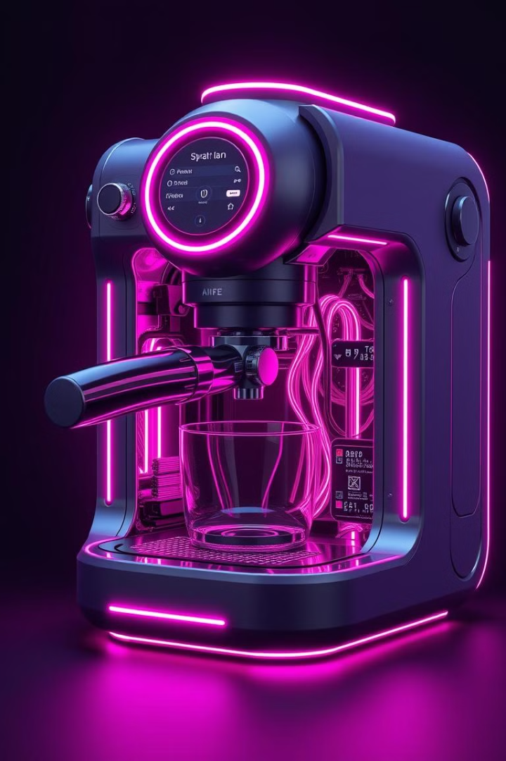
Overview of the Program
1
Purpose
A Python program that simulates a coffee machine.
2
Key Features
Handles multiple coffee types, manages stock, processes payments, and checks for sufficient ingredients.

Slide 3
The Recipe Dictionary
Explanation
Code Snippet
The recipe dictionary holds information about three coffee types, including the required ingredients and the cost of each coffee.
recipe = {
"latte": {
"ingredients": {"water": 200, "sugar": 100, "milk": 200, "coffee": 150},
"cost": 200
},
"espresso": {
"ingredients": {"water": 300, "sugar": 150, "milk": 200, "coffee": 200},
"cost": 300
},
"cappuccino": {
"ingredients": {"water": 300, "sugar": 150, "milk": 400, "coffee": 100},
"cost": 400
}
}

Slide 4
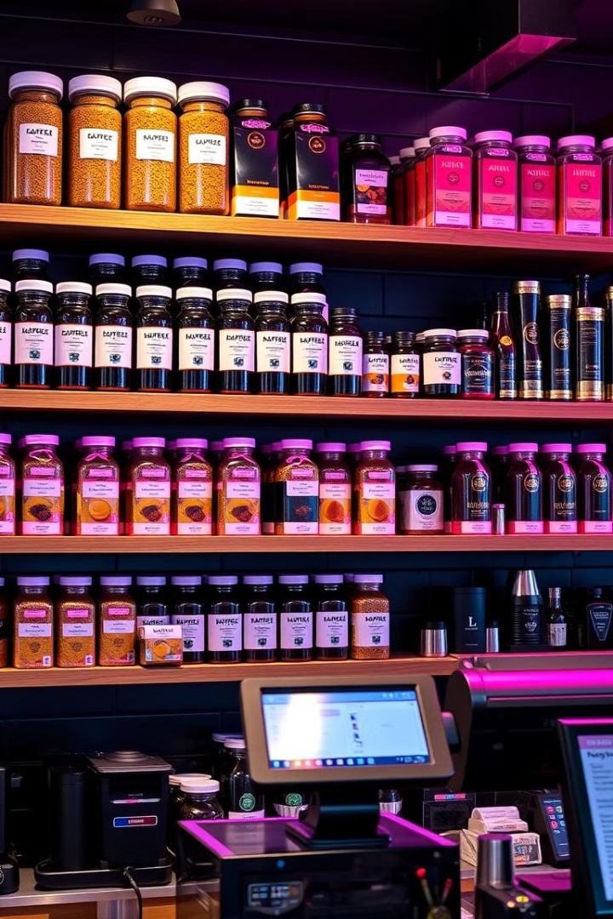
Managing Stock and Earnings
Stock
The program maintains an initial stock of ingredients such as water, sugar, milk, and coffee.
Earnings
The program tracks the total earnings from customer payments.

Slide 5

Main Control Flow
User Input
Brewing
The main() function handles user input, allowing them to select a coffee type, display the stock, and check the earnings.
The brewing() function updates the stock after brewing the coffee and informs the user that their coffee is ready.
1
2
3
Payment Processing
The function processes the payment and triggers the brewing process if the stock is sufficient.

Slide 6



Resource Check Function
Ingredient Check
Insufficient Stock
The resource_check() function ensures there are enough ingredients for the selected coffee.
If an ingredient is lacking, the function alerts the user and cancels the transaction.

Slide 7



Hustle
Challenges
Lack of prior Python knowledge, unfamiliarity with Git and GitHub, time management, and implementing new features.
Overcoming Challenges
Watched tutorials, utilized a Harvard course on Python, and leveraged AI assistance for new features.

Slide 8

Scope for Improvements
1
More Coffee Options
2
Customized Inputs
Expand the coffee machine to include more coffee types.
Allow users to customize their coffee orders.
3
Web-based UI
4
Advanced Features
Develop a web-based user interface to enhance the overall experience.
Implement features like billing operations, detailed earnings reports, and stock refilling.

Slide 9
Conclusion
Summary
Next Steps
This simple coffee machine program demonstrates how Python can be used to manage resources, handle transactions, and control an interactive machine.
Expand the coffee machine to include more coffee types and add features like change calculation and detailed reports.

